Slide 1
9th ETSI ITS Workshop
CEPT/ECC Activities on ITS
Thomas Weilacher Chairman ECC Working Group FM
Thomas Weber
Chairman WG FM Short Range Devices Maintenance Group (SRD/MG)
Berlin, 6-8 March 2018
1

Slide 2
Ongoing activities within CEPT/ECC on ITS
Overview:
Structure and Groups in CEPT/ECC working on ITS
Current Regulation
EC Mandates
Status of Work so far
General Principles and Concept for the Future Regulation
Planned output of CEPT/ECC Work, Organisation and Timeline
ETSI Requests and ECC Requests to ETSI
Importance of the Harmonised Standard for the Regulation
Preparations towards WRC-19 Agenda Item 1.12 in CPG

Slide 4
Current Regulations
Frequency range | Usage | Regulation
5 905 MHz to 5 925 MHz | Future ITS applications | ECC Decision (08)01
5 875 MHz to 5 905 MHz | ITS safety (not limited to road safety In ECC Decision (08)01) | ECC Decision (08)01 EC Decision 2008/771/EC
5 855 MHz to 5 875 MHz | ITS non-safety applications | ECC Recommendation(08)01
In addition:
ECC Decision (09)01 (ERC/REC 70-03 Annex 13) and EC DEC 2006/771/EC (amended by (EU) 2017/1483) for ITS in 63-64 GHz including hybrid radar and vehicle communications systems;
SRD regulation in ERC/REC 70-03 Annex 1 and EC DEC 2006/771/EC (amended by (EU) 2017/1483) for 5725-5875 MHz;
Road Tolling: 5795-5815 MHz incl. in ERC/REC 70-03 Annex 5 and EC Decision 2006/771/EC (amended by (EU) 2017/1483) for SRD;
Existing compatibility studies for 5.9 GHz ITS are mainly in ECC Reports 101 and 228 (all based on ETSI G5 technology – LS from WG SE to 3GPP RAN informed about this).

Slide 5
EC Mandates
EC Mandate to CEPT to study the extension of the Intelligent Transport Systems (ITS) safety-related band at 5.9 GHz
Extending the upper edge of the EC harmonised safety-related ITS band (5875-5905 MHz) by 20 MHz up to 5925 MHz;
In addition to road transport, allowing other means of transport such as Urban Rail using Communication Based Train Control (CBTC) in the EC harmonised safety-related ITS band.
Permanent Mandate to CEPT on SRD (7th Update running now)
Concerns non-safety related ITS in 5855-5875 MHz;
Concerns new Smart Tachograph, Weight and Dimensions Applications in 5795 – 5815 MHz;
Concerns also ITS in 60 GHz.
Responses in 2 CEPT Reports for Public Consultation Approval in October 2018 at CEPT/ECC

Slide 6
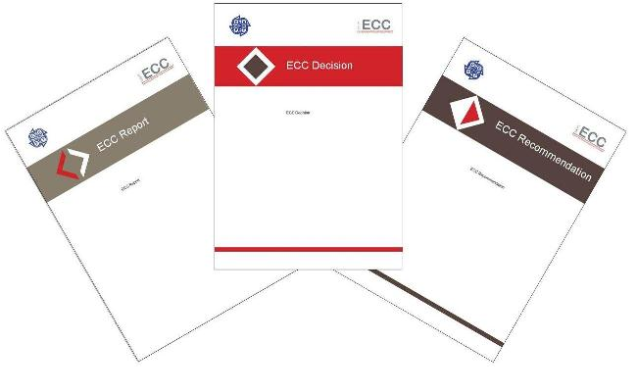
Planned Output of CEPT/ECC Work
2 CEPT Reports – Proposals for MOD of related EC Decisions
Revision ECC Decision (08)01 – ITS in 5875-5925 MHz
Revision ECC Recommendation (08)01 – ITS in 5855-5875 MHz
New ECC Report on additional studies in CEPT/ECC/WGSE
New ECC Report on sharing Road ITS and Urban Rail (CBTC) ITS in CEPT/ECC/WGFM
Inclusions in ERC/REC 70-03 (Annexes 5 and 13), e.g. Smart Tachograph
Revision ECC Decision (09)01 – ‘by-product’ of current review of 60 GHz as set out in ECC’s 5G Roadmap, mainly for wireless access and small cells backhauling applications

Slide 7
Preparations towards WRC-19 Agenda Item 1.12
CPG PTD – concerns 5.9 GHz and 60 GHz
Preliminary CEPT Views:
existing regional harmonisation measures for ITS in 5855-5925 MHz and 63-64 GHz are sufficient
No changes to the RR
measures for ITS on ITU-R level can be achieved through the development of an ITU-R Recommendation (and an ITU-R Report if needed)

Slide 9
Current Process
Initial request from ETSI in Srdoc TR 103 111 for Urban Rail Systems
First analysis performed in WGFM / SRD/MG
Request back to ETSI to find solutions for sharing of Urban Rail (CBTC) ITS and Road (ITS)
Delivery of ETSI TR 103 442 – an ‘interim report’
Reception of the ITS mandate and start of the 7th Update process under the permanent SRD mandate
Request from CEPT to ETSI to deliver a Srdoc for smart Tachograph, weight and Dimensions (first feedback received to get studies started in PT SE24)
Liaison statements from WG FM (02/2017) and ECC (11/2017) on ITS to ETSI

Slide 10
General Principles and Concept for Future Spectrum Regulation
technology neutrality: use of any technology in compliance with ETSI EN 302 571 (or equivalent);
Does not preclude definitions of minimum technical requirements for shared spectrum access;
Mitigation techniques developed through ETSI standardisation;
Uncompromised safety services for all users in case of multiple technologies implementation;
Efficient spectrum use implies that all technologies are at least capable to coexist in the same frequency band;
No segmentation and segregation of the band 5875-5925 MHz. No specific safety related ITS technology or use should be excluded from parts of the spectrum in the band 5875-5925 MHz, as long as they support a sufficiently polite spectrum access and/or interference mitigation which allows sharing of the spectrum in principle.
In line with spectrum access requirements, Urban Rail (CBTC) ITS should be able to use any up-to-date technology.
Avoid deployment issues with the new ITS spectrum regulation. Technical solutions already deployed should stay available for maintenance and evolution. This may imply the provision of sufficiently long transition periods.
Tramways not segregated from road or pedestrian traffic shall be considered as part of Road ITS.

Slide 11
Technologies under Consideration
Road ITS - ITS-G5 and LTE-V2X. LTE-V2X uses in the 5.9 GHz band only the PC5 air interface. ITS-G5 is based on IEEE 802.11/11p specifications.
The overall communication channel loading and decentralized communication traffic congestion control must be such to ensure that safety related messages have a very high predictability to be received by other ITS stations. Future safety related ITS application (e.g. truck platooning) have increased requirements and will support more and more automated driving possibilities, compared with the existing initial driver alert applications in ITS
Urban Rail (CBTC) ITS: DSSS/TDMA, full or modified IEEE 802.11 technology, OFDM based, 3GPP TD-LTE (used in China at 1.8 GHz, not implemented in Europe yet)
If trains cannot transmit messages, they will not be authorised to move. The critical aspect is availability. CBTC therefore includes redundancy and has low latency requirements. The Urban Rail CBTC ITS system has to be sufficiently robust.

Slide 12
Preliminary additional Coexistence Scenarios considered in CEPT/ECC/WGSE
Based on ECC Reports 101 and 228 (studies performed on ITS-G5), verify:
LTE-V2X, whether assumptions and conclusions made in ECC Reports 101 and 228 are valid. This included considerations about TPC, duty cycling and overall transmission activity, coexistence with TTT road tolling;
Urban Rail CBTC, whether the assumptions and conclusions made in ECC Reports 101 and 228 are valid;
whether the conclusions of ECC Report 101, stating that between 5875 MHz and 5925 MHz ITS will not suffer from excessive interference resulting from systems/services other than ITS, are also valid for Road ITS based on LTE-V2X (PC5 air interface) and for Urban Rail CBTC;
coexistence of Smart Tachograph as a new TTT application, different in its usage scenario from road tolling, with ITS;
Impact of Radiolocation below 5850 MHz on LTE-V2X in the non-safety band 5855-5875 MHz;
Impact of FWA in 5725-5875 MHz on LTE-V2X in the non-safety band 5855-5875 MHz and in the adjacent safety band 5875-5925 MHz.

Slide 13
Relation to ETSI Work
CEPT will welcome feedback on the progress of the work developed by ETSI which aims at providing a detailed and agreed technical standard allowing practical implementation of ITS applications (road, urban rail) in the 5875-5925 MHz band.
CEPT has invited ETSI to provide information, concerning the spectrum sharing of LTE-V2X and ITS-G5, about commonalities and differences of the spectrum access mechanisms and their capabilities for sharing; for those in use or intended for use by the various technologies (ITS-G5, LTE-V2X, technologies to support CBTC) and whether this implies that specific actions are necessary to ensure compatibility between them.
No solution for co-channel operations is expected between ITS-G5 and LTE-V2X based on currently available specifications. The sharing solutions for ITS-G5 and LTE-V2X in the band 5855-5925 MHz should be addressed in the standardisation.

Slide 14
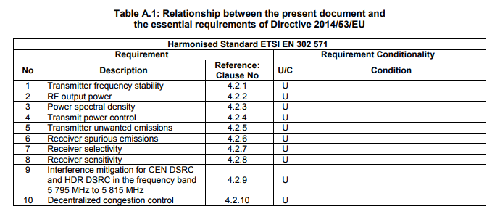
Importance of the ETSI EN 302 571
Allow the use of any technology that falls within the definition of ITS in compliance with the applicable harmonised standard ETSI EN 302 571 (or equivalent):

Slide 15
60 GHz
Subject: Review regulatory approach for wideband data transmission systems in 57-66 GHz and ITS
Identify solutions to improve the sharing situation with ITS in the 60 GHz range.
The focus is on fixed application under license-exempt regulation in the 57-66 GHz range for small cells backhauling and wireless access, while nomadic and mobile use should not be excluded. The effect of alignment of the ITS band with the channeling of the wideband data transmission system should also be considered.
An ETSI SRdoc covering ITS and wideband data transmission systems is under preparation.
Work in SRD/MG and PT SE19

Slide 16
Organisation & Timeline
9 March 2018 – SRDMG Web-meeting on ITS
9-13 April 2018 – SE24 and SRD/MG – Rome
3-7 September 2018 – SE24 and SRD/MG
20-21 September 2018 – SRD/MG
24-28 September 2018 – WGFM#92
23-26 October 2018 – ECC (PC Approval)
19-21 December 2018 - SRDMG (Comment Resolution PC)
Further Info from ETSI on LTE V2X characteristics for SE24 studies and on Smart Tachograph by June 2018
Info from ETSI on Road ITS- Urban Rail (CBTC) ITS coexistence by August 2018
Info from ETSI on ITS G5-LTE V2X by August 2018

Slide 17
Finally..
Thank you very much
Further information on: www.cept.org/ecc

